Slide 1
CE80362 : Circuit Analysis
Lecture 1:
Passive circuit elements

Slide 2
Definition.
The circuit elements can be categorized into two types,
active elements
passive elements.
A Passive element is an element which cannot deliver more energy to the circuit that what is supplied to it by the circuit.
Resistors, capacitors, inductors
An Active element, delivers more energy to the circuit than what the circuit supplies to it.
All Power sources (i.e. current or voltage sources) are active elements
Passive elements do not generate (convert from non-electrical energy) any electricity. They may either consume energy

Slide 3

1. Resistance
Electrical resistance is the property of a material by virtue of which it opposes the flow of electrons through the material.
Thus the resistance restricts the flow of electric current through the material.
The unit resistance being “ohm” (Ω) quantitatively it is obtained from ohm’s law
The Circuit symbols for Resistance are shown in the figures below.

Slide 4
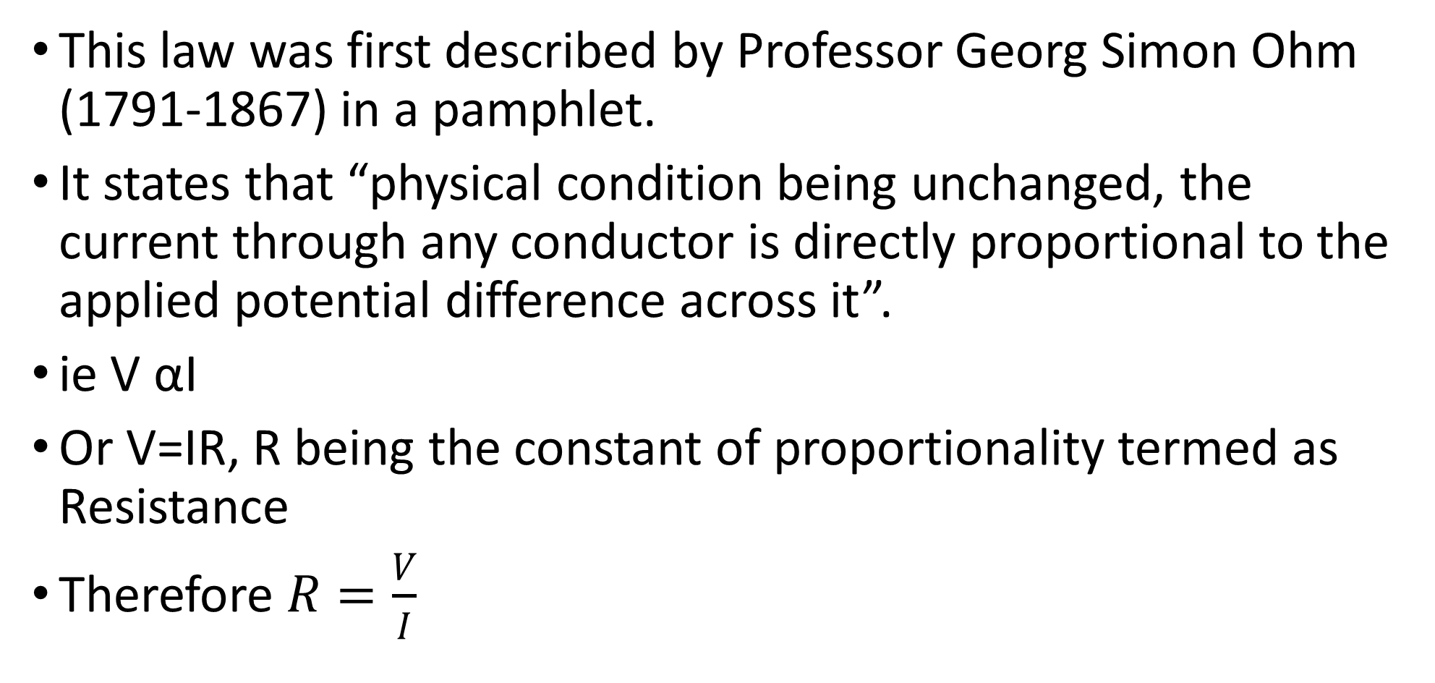
The Ohm’s Law
This law was first described by Professor Georg Simon Ohm (1791-1867) in a pamphlet.
It states that “physical condition being unchanged, the current through any conductor is directly proportional to the applied potential difference across it”.
ie V αI
Or V=IR, R being the constant of proportionality termed as Resistance
Therefore $R=\frac{V}{I}$

Slide 5
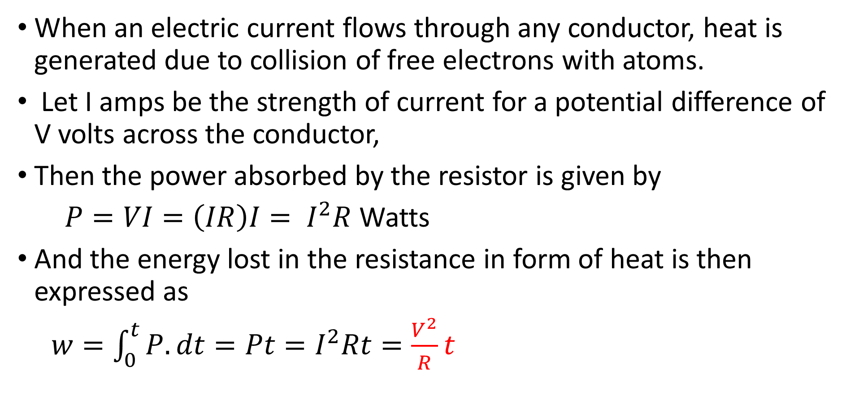
The Ohm’s Law contd’
When an electric current flows through any conductor, heat is generated due to collision of free electrons with atoms.
Let I amps be the strength of current for a potential difference of V volts across the conductor,
Then the power absorbed by the resistor is given by
$P=VI=\left(IR\right)I= I^{2}R$ Watts
And the energy lost in the resistance in form of heat is then expressed as
$w=\int_{0}^{t}{P.dt}=Pt=I^{2}Rt=\frac{V^{2}}{R}t$

Slide 6

2 Inductance
The inductance is the property of a material by virtue of which it opposes any change of magnitude or direction of electric current passing through the conductor.
The unit of inductance being “henry” (L),
It is given by Faraday’s law of electromagnetic induction.
Inductance is said to be one henry when current through a coil of conductor changes at the rate of one ampere per second inducing one volt across the coil.

Slide 7
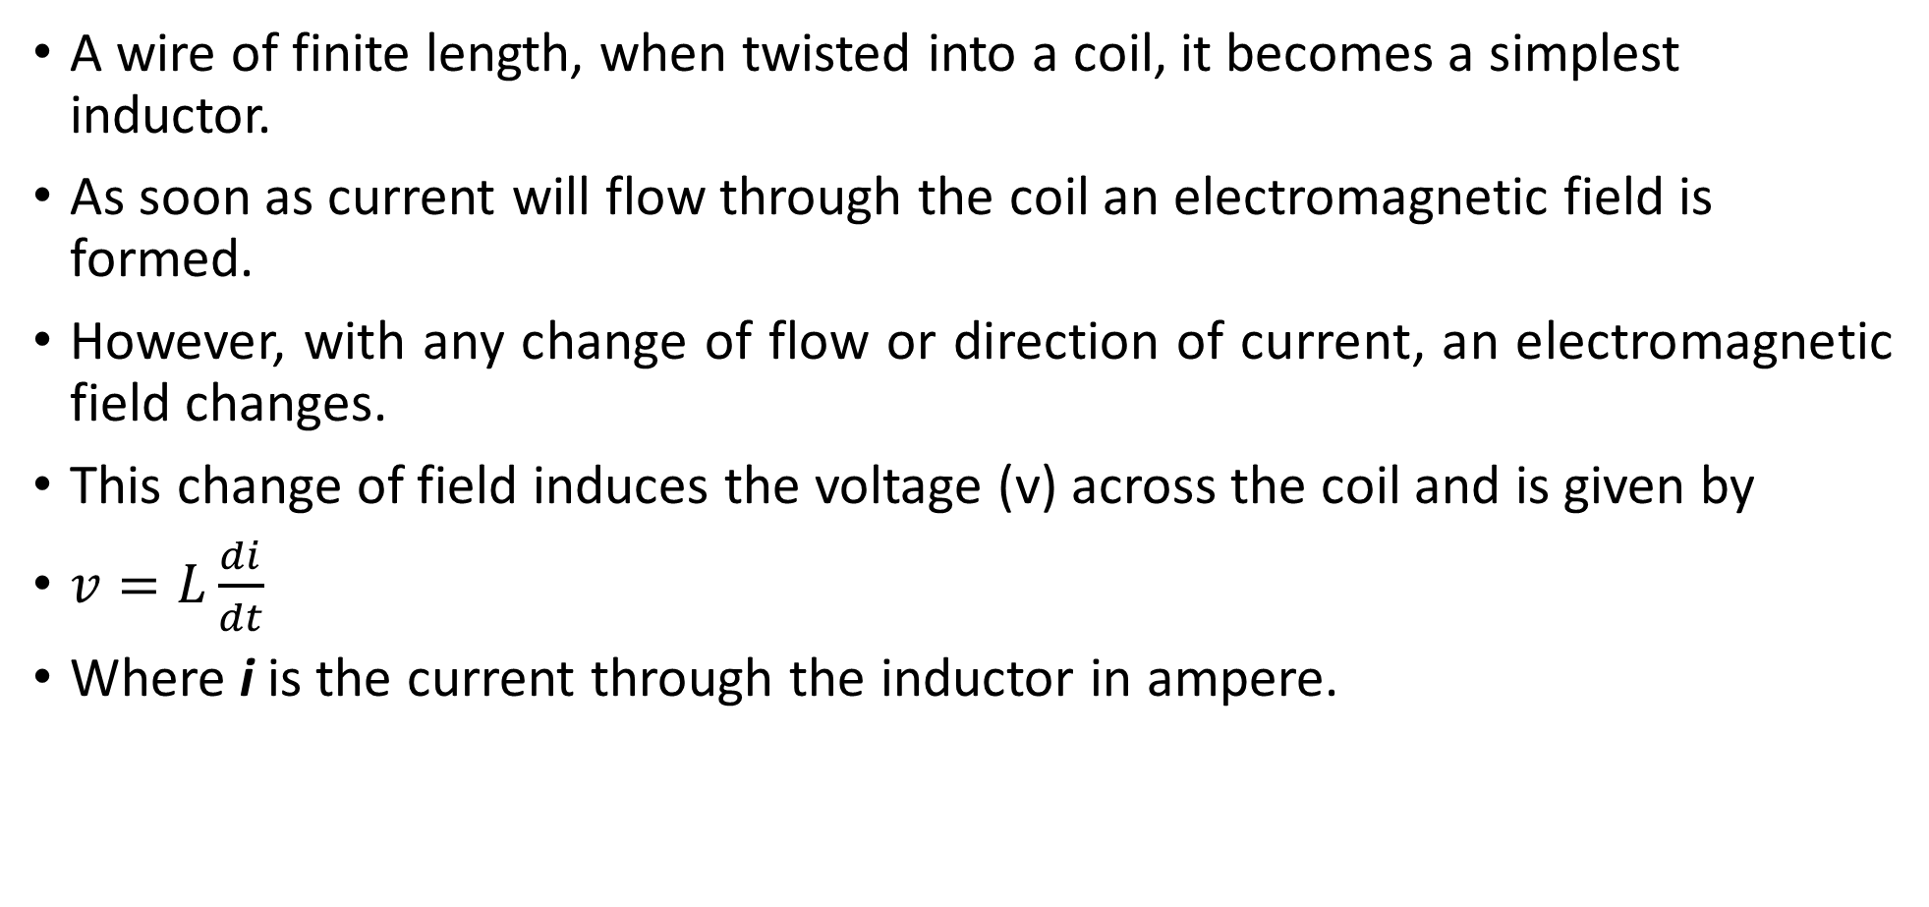
Cntd’
A wire of finite length, when twisted into a coil, it becomes a simplest inductor.
As soon as current will flow through the coil an electromagnetic field is formed.
However, with any change of flow or direction of current, an electromagnetic field changes.
This change of field induces the voltage (v) across the coil and is given by
$v=L\frac{di}{dt}$
Where i is the current through the inductor in ampere.

Slide 8
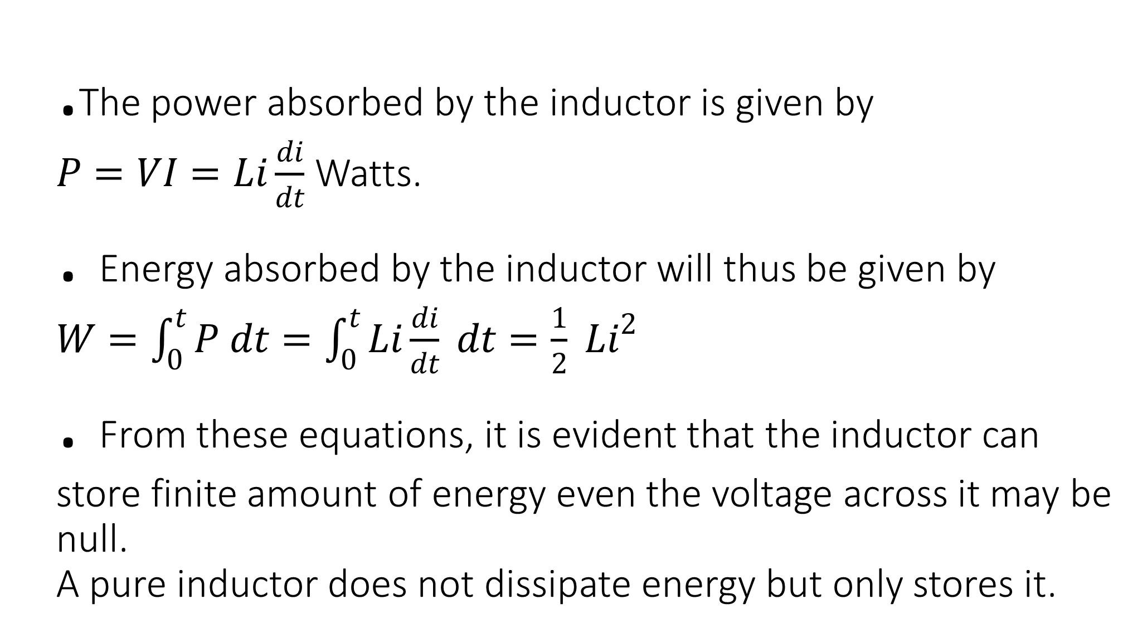
.The power absorbed by the inductor is given by
$P=VI=Li\frac{di}{dt}$ Watts.
. Energy absorbed by the inductor will thus be given by
$W=\int_{0}^{t}{P dt}=\int_{0}^{t}{Li\frac{di}{dt}} dt=\frac{1}{2} Li^{2}$
. From these equations, it is evident that the inductor can store finite amount of energy even the voltage across it may be null.
A pure inductor does not dissipate energy but only stores it.

Slide 9

3 Capacitance
This is the capability of an element to store electric charge within it.
A capacitor stores electric energy in the form of electric field being established by the two polarities of charges on the two electrodes of a capacitor.
Quantitatively capacitance is a measure of charge per unit voltage that can be stored in an element.
The unit of capacitance (C) is fared (F).
The capacity is said to be one fared provided one coulomb of charge can be stored with one volt across the two electrodes of the element.

Slide 10

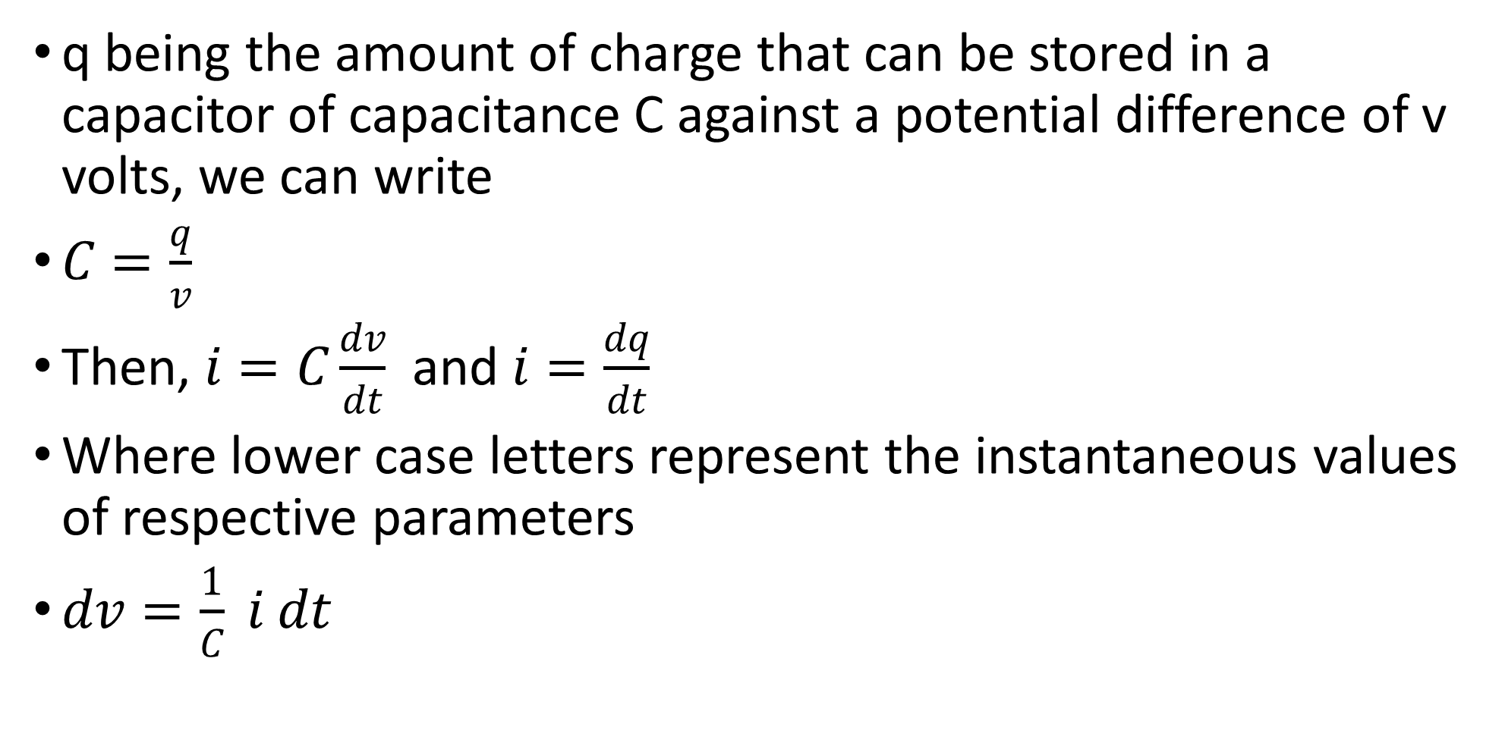
Capacitance calculation
q being the amount of charge that can be stored in a capacitor of capacitance C against a potential difference of v volts, we can write
$C=\frac{q}{v}$
Then, $i=C\frac{dv}{dt}$ and $i=\frac{dq}{dt}$
Where lower case letters represent the instantaneous values of respective parameters
$dv=\frac{1}{C} i dt$

Slide 11
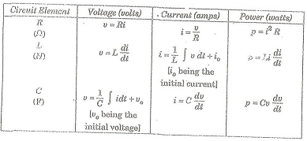
Voltage current relationship of circuit elements

Slide 12
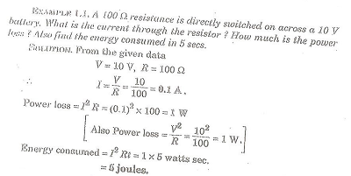
Examples

Slide 13
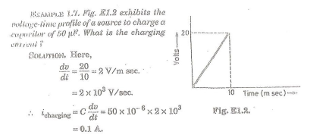

Slide 14
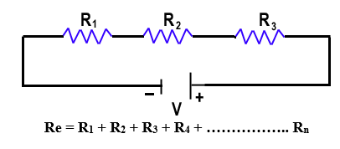
4. Series combination of Resistances
Consider three resistances R1, R2, & R3 connected in series combination with a power supply of voltage.
The Potential difference of each resistor is V1, V2, & V3 respectively.
Let electric current I is passing through the circuit shown below.

Slide 15
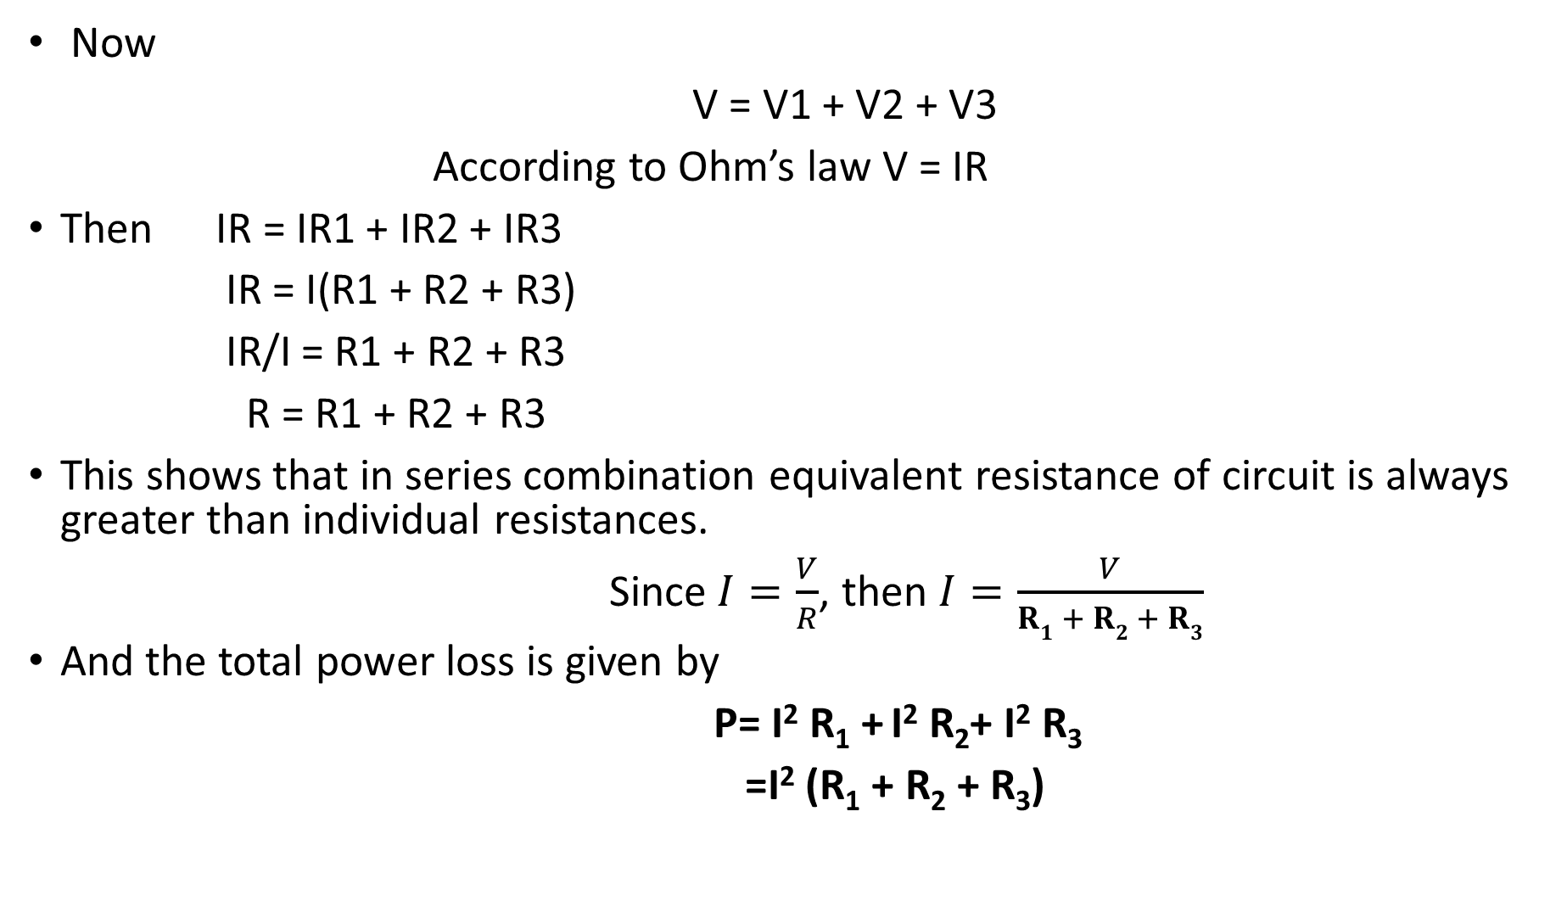
Now
V = V1 + V2 + V3
According to Ohm’s law V = IR
Then IR = IR1 + IR2 + IR3
IR = I(R1 + R2 + R3)
IR/I = R1 + R2 + R3
R = R1 + R2 + R3
This shows that in series combination equivalent resistance of circuit is always greater than individual resistances.
Since$I=\frac{V}{R}$, then $I=\frac{V}{R1 + R2 + R3}$
And the total power loss is given by
P= I² R₁ + I² R₂+ I² R₃
=I² (R₁ + R₂ + R₃)

Slide 16

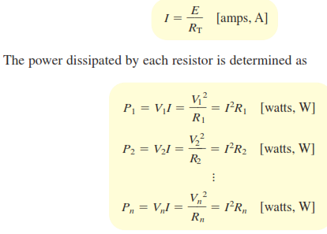

Slide 17
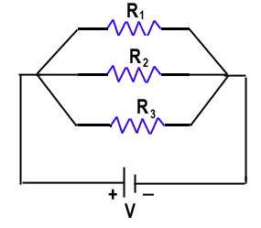
Parallel combination of Resistances
Consider three resistances R₁, R₂ & R₃ connected in parallel combination with a power supply of voltage V as shown below.

Slide 18


Now
I = I₁ + I₂ + I₃
According to Ohm’s law
V/R = I
Therefore, V/R = V/R₁ + V/R₂ + V/R₃
V/R = V (1/R₁ + 1/R₂ + 1/R₃) dividing by V we obtain
1/R = 1/R₁ + 1/R₂ + 1/R₃
Similarly, for the calculation of two resistances R₁ and R₂ connected in parallel:

Slide 19

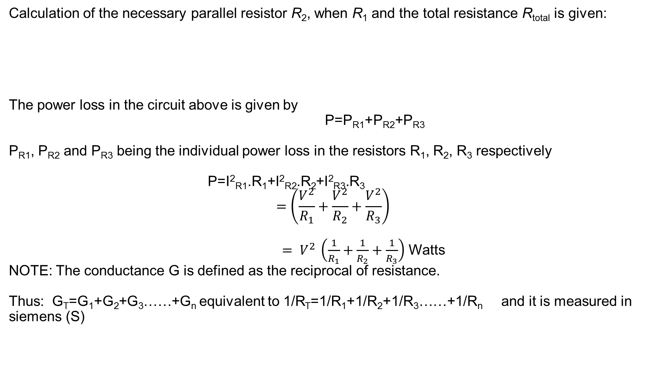
Calculation of the necessary parallel resistor R₂, when R₁ and the total resistance R_{total} is given:
The power loss in the circuit above is given by
P=P_{R1}+P_{R2}+P_{R3}
P_{R1}, P_{R2} and P_{R3} being the individual power loss in the resistors R₁, R₂, R₃ respectively
P=I²_{R1}.R₁+I²_{R2}.R₂+I²_{R3}.R₃
$$=\left(\frac{V^{2}}{R_{1}}+\frac{V^{2}}{R_{2}}+\frac{V^{2}}{R_{3}}\right)$$
$= V^{2 }\left(\frac{1}{R_{1}}+\frac{1}{R_{2}}+\frac{1}{R_{3}}\right)$ Watts
NOTE: The conductance G is defined as the reciprocal of resistance.
Thus: G_{T}=G₁+G₂+G₃……+G_{n} equivalent to 1/R_{T}=1/R₁+1/R₂+1/R₃……+1/R_{n} and it is measured in siemens (S)

Slide 20
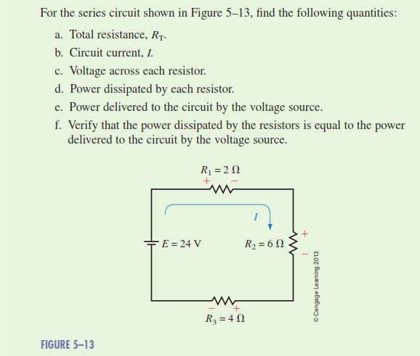
Example on series combination

Slide 21
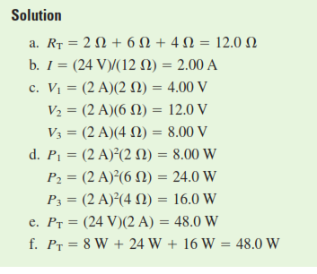

Slide 22
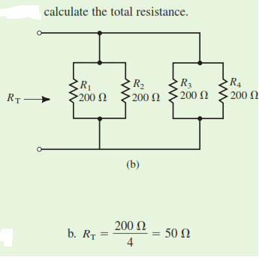
Example on parallel combination
If the values of the resistors are equal. Just divide single value with the number of resistors as the lowest common multiple is one of the provided values.

Slide 23
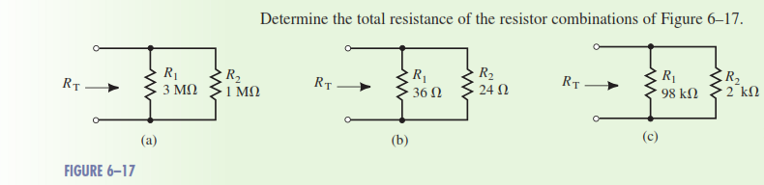
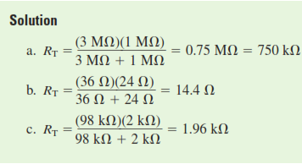
Example on parallel combination for different values
In this case, we follow the equation for calculation of resistors in parallel

Slide 24
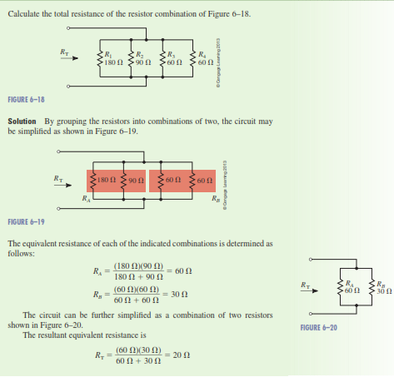

Slide 25
Note:
1.the resistors may connected in both parallel and series in the same network.
In this case, series equation applies on series connection and parallel equation applies on parallel connection.
First make the circuit in series connection and then find the equivalent resistance.
Connection in Example 2 is different from example 3, so do not confuse them. First you need to understand how the source is connected to the entire circuit.

Slide 26
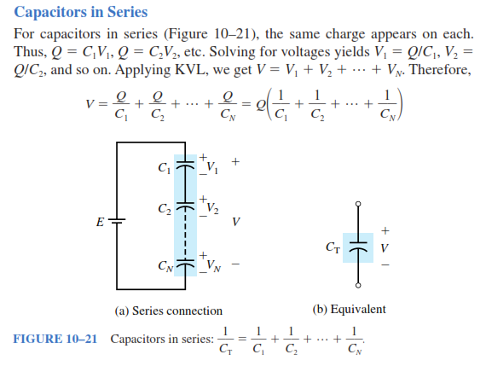
Series and Parallel combination of Capacitors

Slide 27
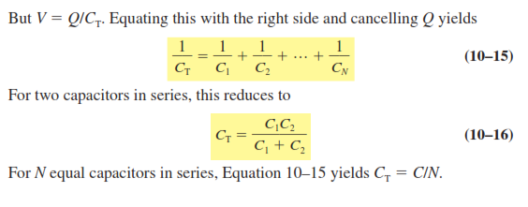

Slide 28
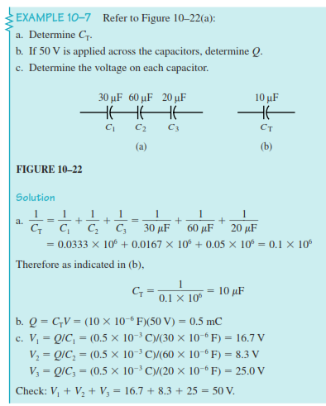

Slide 29
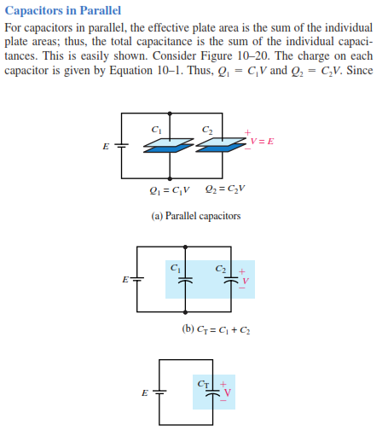

Slide 30
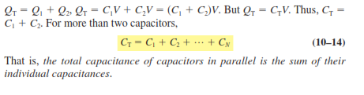
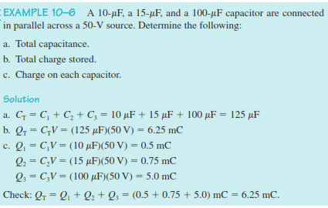

Slide 31
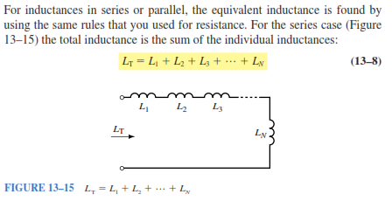
Series and Parallel combination of Inductances

Slide 32
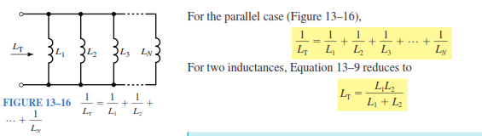

Slide 33
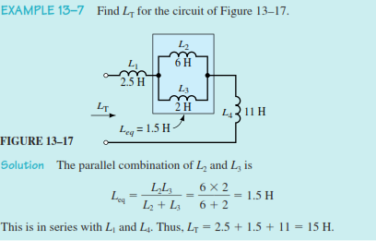
examples

Slide 34
Reference books
Circuit Analysis. Theory & Practice, 5E by Wilhelm Miller
Circuit Analysis Theory and Practice 3rd ed
Circuit theory (Analysis and Synthesis), by A. Chakrabarti
A textbook of ELECTRICAL TECHNOLOGY, by B.L. Theraja and A.K. Theraja.
Other books, in library with almost the same contents.

